Slide 1
Recognition of Handwritten Digits and Mathematical Expressions
Under the Guidance of : Prof. Joydeep Sengupta
Made By : 1) Nihal Gandhi
2) Sanskar Jhanwar
3) Juhily Ashtikar
4) Soujanya Priya

Slide 2
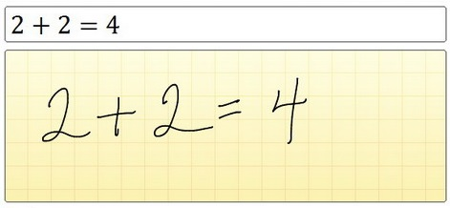
Introduction
What is Handwritten Recognition?

Slide 3
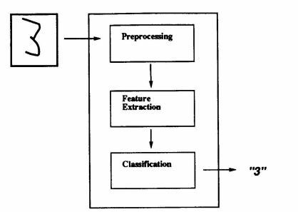
Steps
Pre-processing
HOG features extraction
Support vector machines classification.

Slide 4
Preprocessing
Grayscale conversion
Gaussian Blurring
Thresholding
Contour Detection
Contour Sorting
Resizing Contour

Slide 5
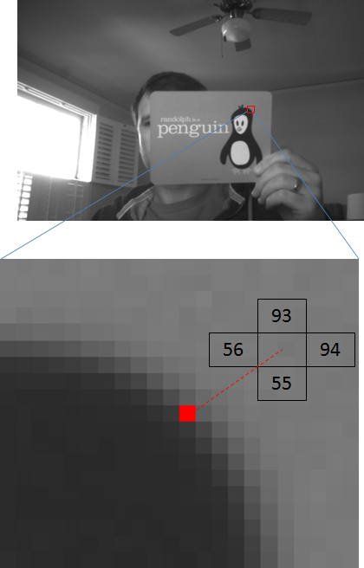
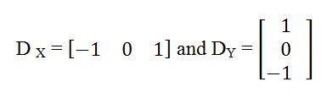
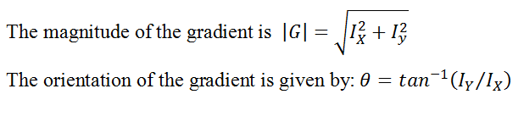

HOG

Slide 6
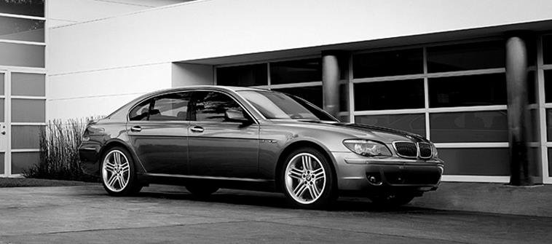
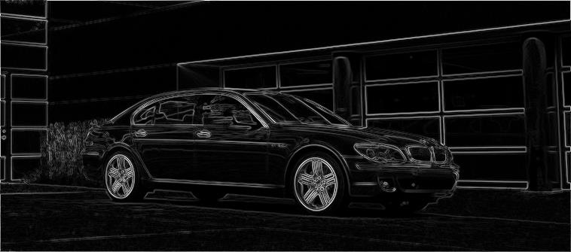
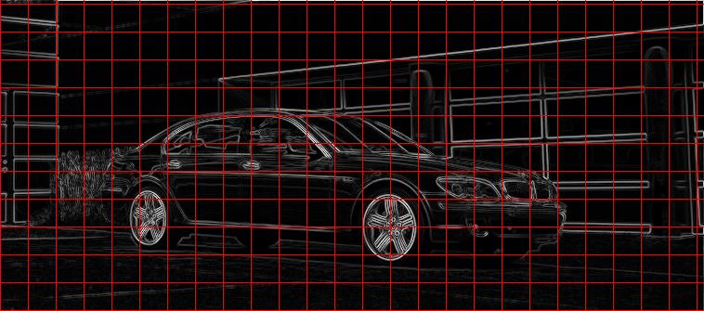
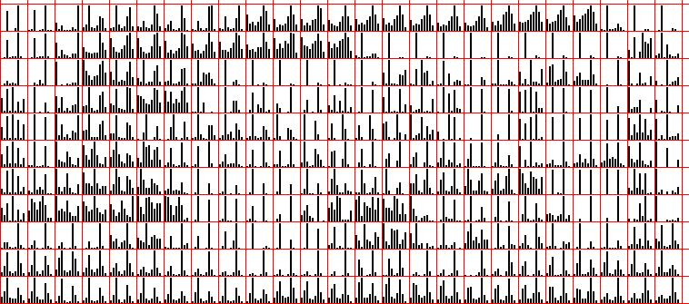
HOG

Slide 7
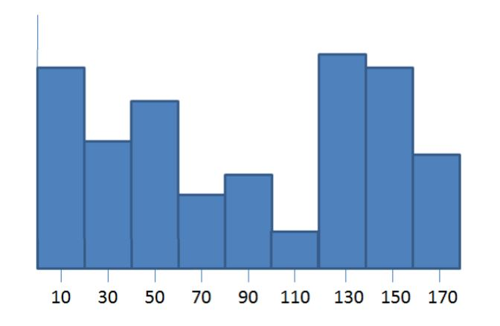
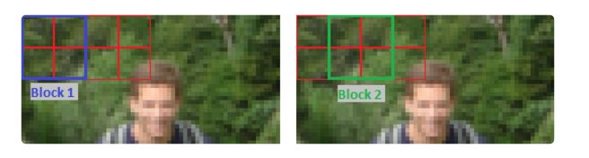
HOG
We take the 64 gradient vectors (in our 8x8 pixel cell) and put them into a 9-bin histogram. The Histogram ranges from 0 to 180 degrees, so there are 20 degrees per bin
Each block contains 4 cells with a 9-bin histogram for each cell, for a total of 36 values per block. Final Descriptor size = 7 blocks across x 15 blocks vertically x 4 cells per block x 9-bins per histogram = 3,780 values

Slide 8
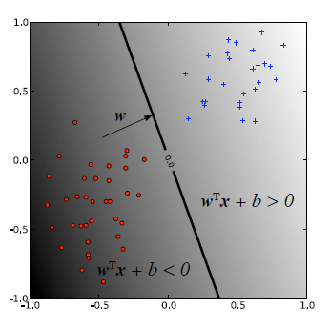
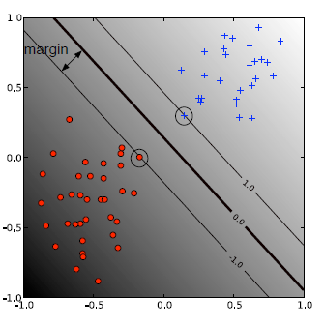
SVM

Slide 9
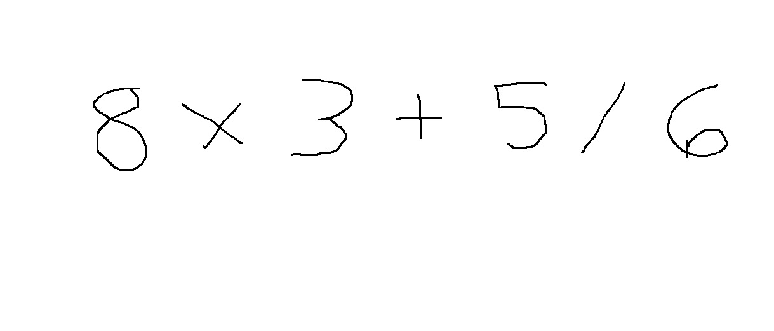
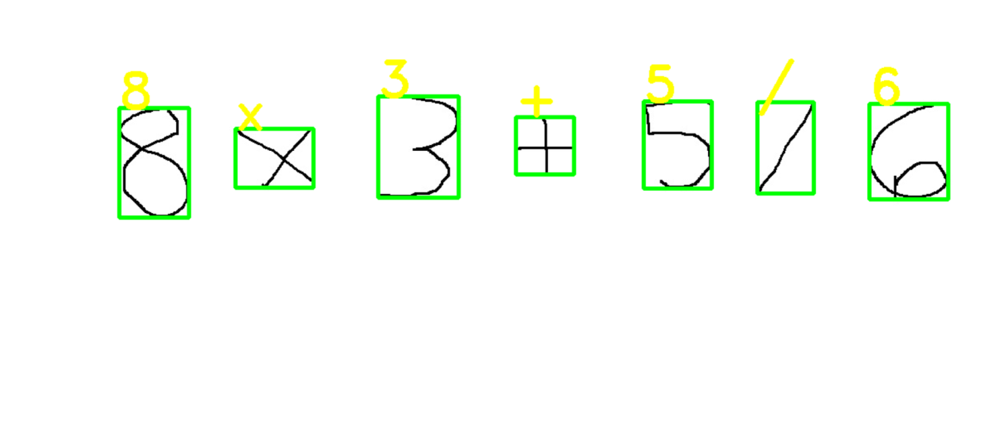
Implementation
Input Image
Output Image

Slide 10
Assumptions of Testing
The digits should be sufficiently apart from each other
For the images which we used in testing, fixed thresholding worked pretty well. In most real world images, we need to use adaptive thresholding
In the pre-processing step, we only did Gaussian blurring. In most situations, we will need to open and close the image to remove small noise pixels and fill small holes.

Slide 11
Problems Faced
Contour detection problem
Division symbol detection
Differentiation between the symbols

Slide 12
Conclusion and Future Aspects
The system has already performed well in a practical setting, as it was used to efficiently typeset many of the basic mathematical expressions
Furthermore, recognition accuracy rates within its domain have been very promising
Improve accuracy using stroke-partitioning and text segmentation algorithms
Create a hardware based full functioned equation editor enabling real-time calculations

Slide 13
THANK YOU!

